Slide 1

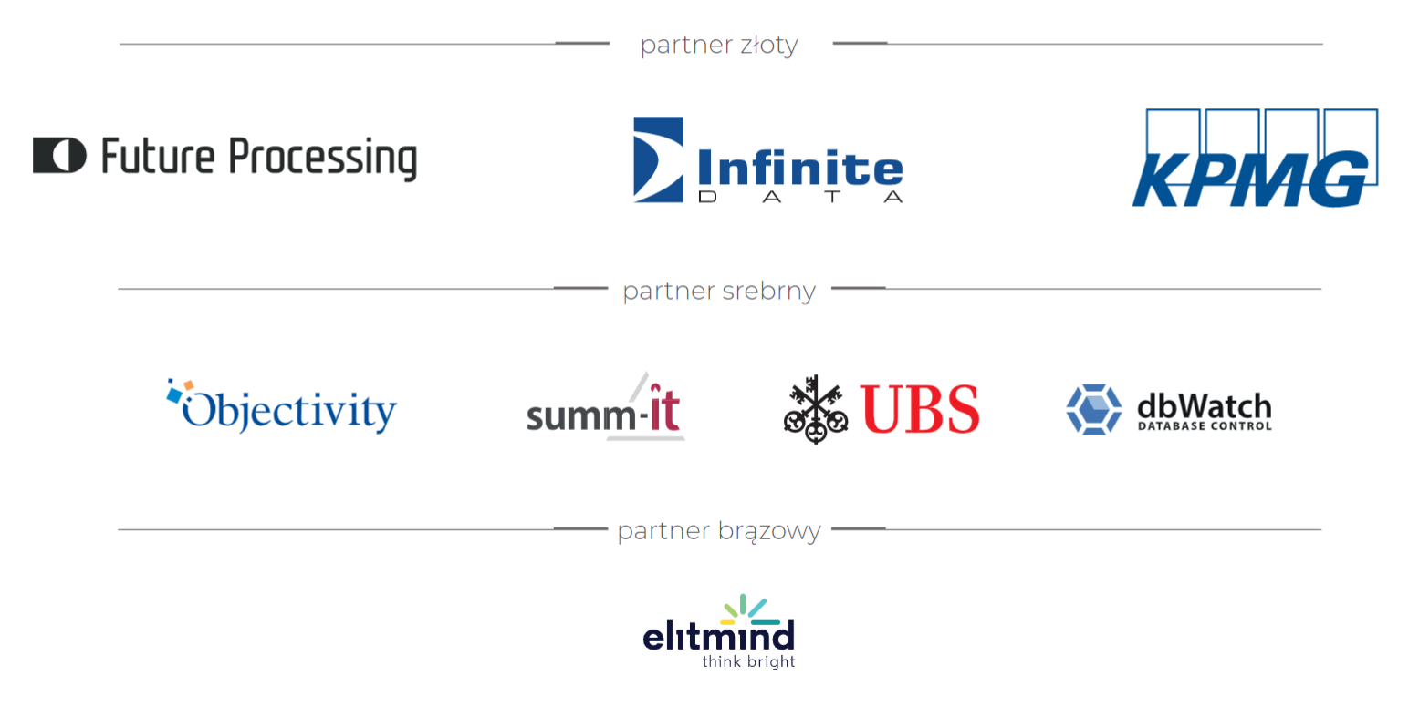

Slide 2

Pułapki w DAX
Tomasz Gołaszewski

Slide 3

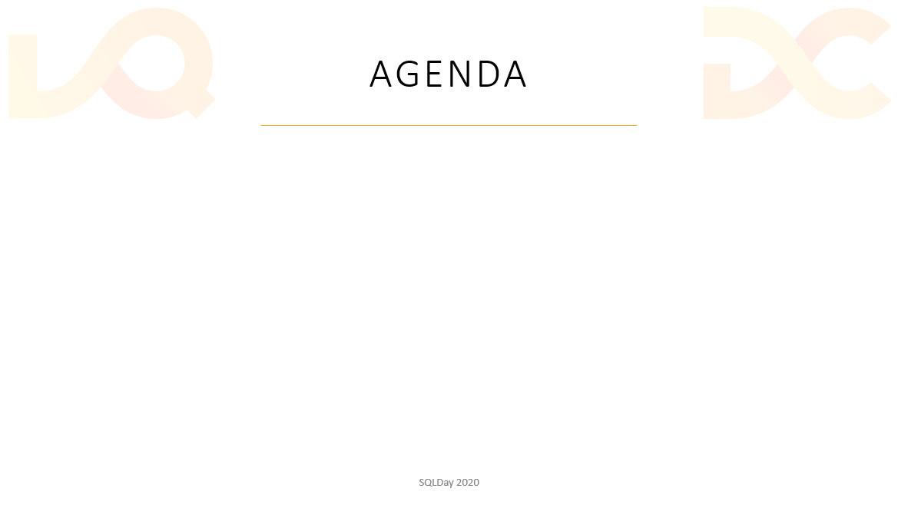
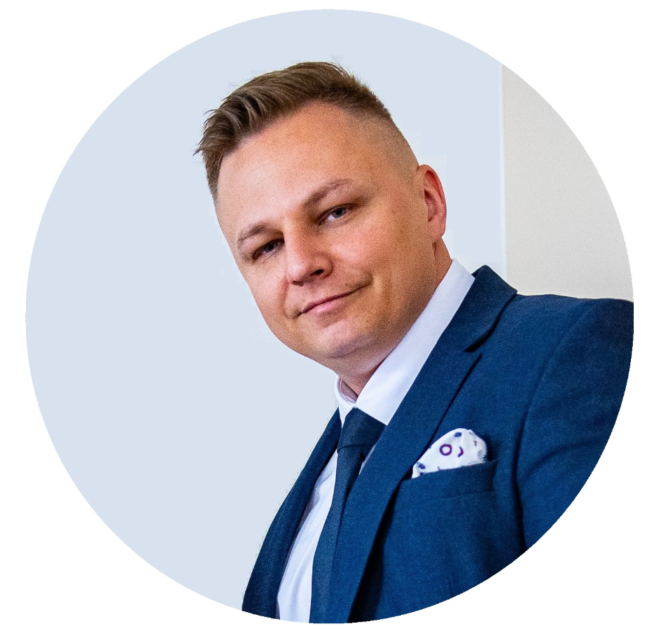
















SPEAKER
Senior Data Architect in DXC Technology
Specialization: Data Warehousing, Reporting & Azure
Member and Speaker of Data Community
Tomasz Gołaszewski
SQLDay 2022

Slide 4
Demo 1-4

